Slide 1
Algebra 4
Day 75

Slide 2
From Last Time
Page 439 # 1, 3, 5, 7, 8, 26
Page 447 # 17, 19, 29, 32

Slide 3
Quiz

Slide 5
7.5 Exponential and Log Equations
Objective:
Solve exponential and log equations

Slide 6
Strategies to Solve:
1.) One to One: rewrite so the bases are the same and compare
2.) Rewrite exponential in log form and apply the Inverse Property
3.) Rewrite log in exponential form and apply the Inverse Property

Slide 7

Examples: Solve
${1.) 3}^{x}=81$
2.) ln x–ln 2 = 0
${3.) 2}^{x}=8$
${4.) log}_{6}{2x=4}$

Slide 8
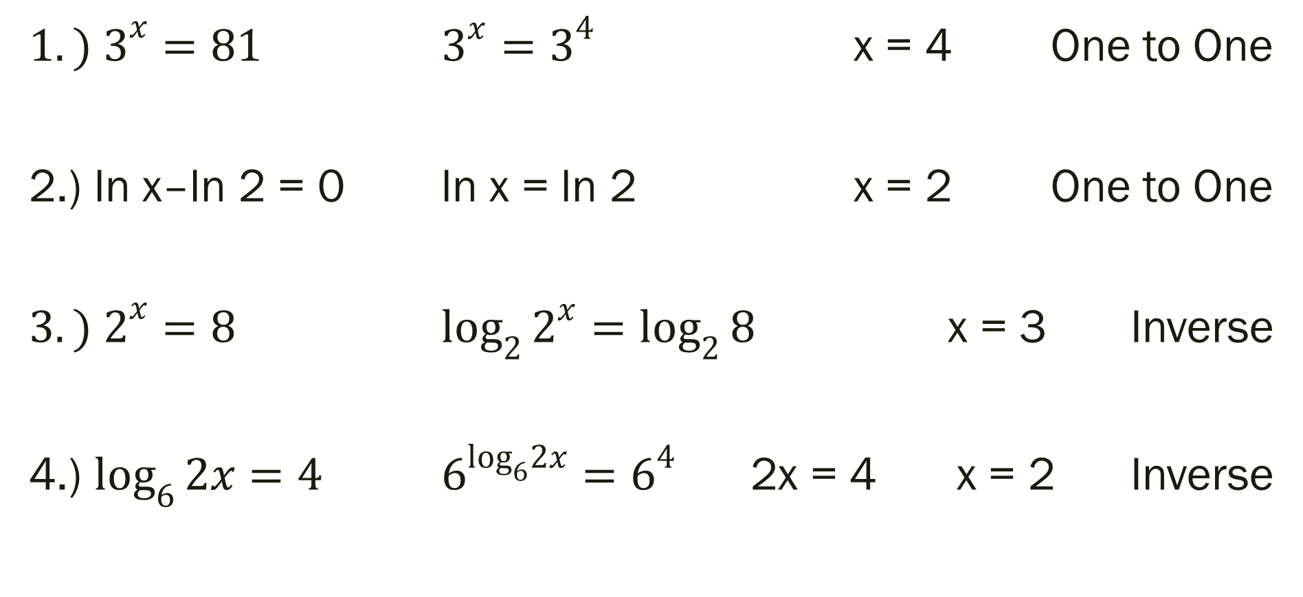
Examples
${1.) 3}^{x}=81$ $3^{x}=3^{4}$ x = 4 One to One
2.) ln x–ln 2 = 0 ln x = ln 2 x = 2 One to One
${3.) 2}^{x}=8$ $\log_{2}{2^{x}=\log_{2}{8}}$ x = 3 Inverse
4.) $\log_{6}{2x=4}$ $6^{\log_{6}2x}=6^{4}$ 2x = 4 x = 2 Inverse

Slide 9
For Next Time
Page 473 #1–5, 7–23 (odd), 33–41 (odd)

